Slide 1
TASK 6
PART -2
Topic:-Cloud computing
Shivam(2000300100214)

Slide 2
Abstract
Cloud Computing: Theory and Practice provides students and IT professionals with an in-depth analysis of the cloud from the ground up. Beginning with a discussion of parallel computing and architectures and distributed systems, the book turns to contemporary cloud infrastructures, how they are being deployed at leading companies such as Amazon, Google and Apple, and how they can be applied in fields such as healthcare, banking and science. The volume also examines how to successfully deploy a cloud application across the enterprise using virtualization, resource management and the right amount of networking support, including content delivery networks and storage area networks. Developers will find a complete introduction to application development provided on a variety of platforms.

Slide 3
Introduction
Cloud Computing provides us a means by which we can access the applications as utilities, over the Internet. It allows us to create, configure, and customize applications online. With Cloud Computing users can access database resources via the internet from anywhere for as long as they need without worrying about any maintenance or management of actual resources.

Slide 4
Theory of Cloud computing
Cloud computing is a service, which offers customers to work over the internet. It simply states that cloud computing means storing and accessing the data and programs over the internet rather than the computer’s hard disk.
The data can be anything such as music, files, images, documents, and many more.
The user can access the data from anywhere just with the help of an internet connection. To access cloud computing, the user should register and provide with ID and password for security reasons.
The speed of transfer depends on various factors such as internet speed, the capacity of the server, and many more.
The management of Cloud Computing is done by the host itself as they come up with new modifications, which continuously improves the service.
The host has an ample amount of storage and fast processing servers, through which the data gets accessed very quickly. Cloud Computing major advantage is that the user can only concentrate on the job while leaving the problems behind.

Slide 5
Application
Windows Azure is usually misinterpreted as just a hosting solution, but there is a lot more that can be done using Windows Azure. It provides a platform to develop applications using a range of available technologies and programming languages. It offers to create and deploy applications using .net platform, which is Microsoft's own application development technology. In addition to .net, there are many more technologies and languages supported. For example, Java, PHP, Ruby, Oracle, Linux, MySQL, Python.Windows Azure applications are scaled by creating multiple instances of the application. The number of instances needed by the application is specified by while the developer while hosting the applications. If traffic is increased or decreased on the website or web application it can be managed easily by logging in to Windows Azure management portal and specifying the instances. Load balancing can also be automated which would allow Azure to make the decision itself as when to assign more resources to application.

Slide 6

Research
Cloud Cube model, helps to categorize the cloud network based on the four-dimensional factor. Their main focus is to protect and secure the cloud network. This cloud cube model helps to select cloud formation for secure collaboration.
This model helps IT managers, organizations, and business leaders by providing the secure and protected network.
Security is an important concern for cloud customers and most of the cloud providers understand it. The customer should also keep in mind, the selected cloud formation meets the regulatory and location requirements.

Slide 7
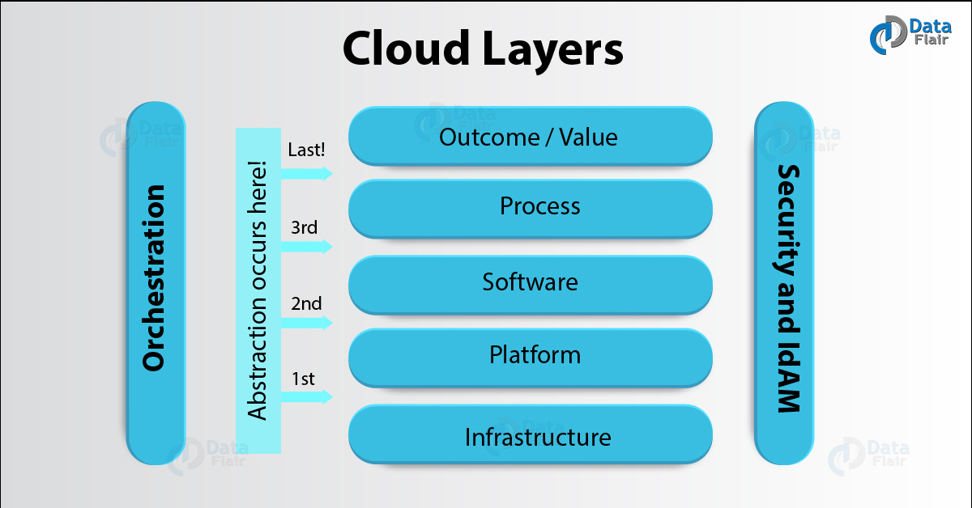
Dimensions of Cloud Cube Model
Cloud Cube model has four dimensions to categorized cloud formations:
1)Internal/External
2)Proprietary/Open
3)De-Perimeterized/Perimeterized
4)Insourced/Outsourced Dimension

Slide 8
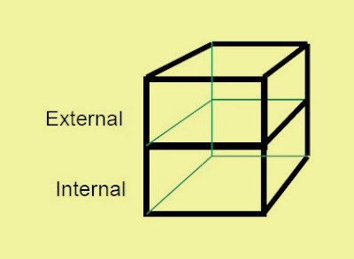
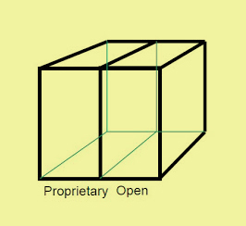
i. Internal/External *The most basic cloud form is the external and internal cloud form. The external or internal dimension defines the physical location of the data. It acknowledges us whether the data exists inside or outside of your organization’s boundary. ii. Proprietary/Open The second type of cloud formation is proprietary and open. The proprietary or open dimension states about the state of ownership of the cloud technology and interfaces. It also tells the degree of interoperability, while enabling data transportability between the system and other cloud forms.

Slide 9
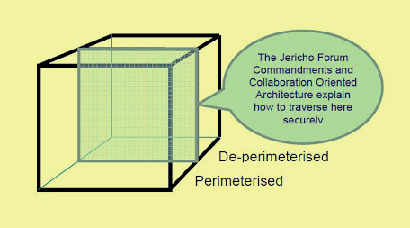
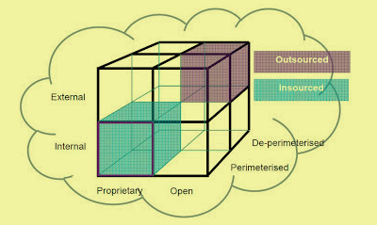
iii. De-Perimeterized/Perimeterized *Perimeterized dimension means, continuing to operate within the traditional it boundary, orphan signaled by network firewalls. With the help of VPN and operation of the virtual server in your own IP domain, the user can extend the organizations perimeter into external Cloud Computing domain. This means that the user is making use of the own services to control access. De-perimeterized dimension means the system perimeter is architected on the principles outlined in the Jericho forums commandments. In De-perimeterized dimension, the data will be encapsulated with metadata and mechanisms, which will further help to protect the data and limit the inappropriate usage.
iv. Insourced/Outsourced
*The Insourced and outsourced dimensions have two states in each of the eight cloud forms. In the outsourced dimension the services provided by the third party, whereas in the insourced dimension the services provided by the own staff under the control.
iii->> iv->>

Slide 10
How to Secure Data in the Cloud Cube Model?
There are some steps and points to keep in mind before securing your data in a cloud cube model:
1)The classification of the data, the customer should know what rules must be applied to protect it.
2)It should be ensured, the data exist only in specific trust levels.
3)It should check that what regulatory compliance and restrictions are applicable. For example, the data should stay in a particular boundary and whether it has to stay in the safe harbour or not.
After the data is classified and is ready to put in the required zone, the assigned person is in a position to decide the following factors-The data and processes, which are to be moved in the cloud.At what level the user wants to operate in the cloud. It can be infrastructure, platform, software, or platform as a service.The cloud formations, which are mostly compatible as per the requirement.The level of operation in the cloud can be different as per the requirement.Below is the chart which shows the Cloud layers, where the cloud operates.

Slide 11
Conclusion
Hence, we can use Cloud Computing for remote processing of the application, outsourcing, and data giving quick momentum. The above Cloud Computing research topics can help a lot to provide various benefits to the customer and to make the cloud better.
With these cloud computing research, we can make this security more advanced. There are many high-level steps towards security assessment framework. This will provide many benefits in the future to cloud computing.

Slide 12
References
1)Dataflairtraining.com
2)Wikipedia
3)Slideshare.net
4)Researchgate.com

Slide 13

THANK YOU!!

